Slide 1
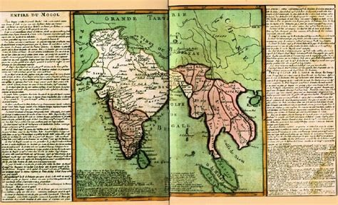

Bara-Bhuiyans
Prepared by : Mehrin Farzana &
Kamrunnahar Keya
ID: 2101013 &
2101025
IoT, 2021-22, BDU
Date: 12-4-23
EMPIRE DU MOGOL

Slide 2
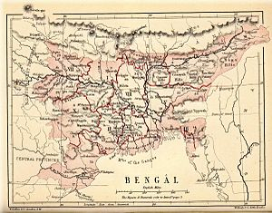
Topics
Who were the Bara-Bhuiyans?
Where were the Bara-Bhuiyans?
Rise of the Bara-Bhuiyans
Some of the Bhuiyans
Fall
Kandarpa Roy
Laxman Manikkyo
Isha Khan
Protapadittyo Roy
Chand Roy
Mukundaram Roy
Musa Khan
Kedar Roy
Ram
chandra
Ananta Manikkyo
Map of "Bengal" from Pope, G. U. (1880)

Slide 3
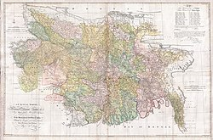


Who were the Bara-Bhuiyans?
During the reign of Mughal emperor Akbar and Salim aka. Jahangir, the powerful landlords of “vaanti “ area over whom the Mughals could not establish autority are called the Bara-Bhuiyans.
They were appointed by the Mughlas to collect taxes and other customary but later declaired indeendance for themselves
‘Bara’ means many or countless
Map of the Bengal Subah

Slide 4
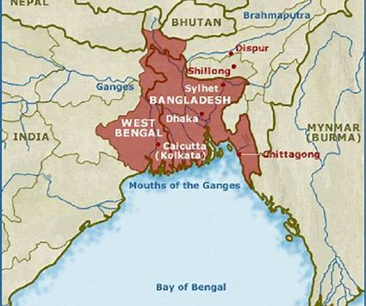
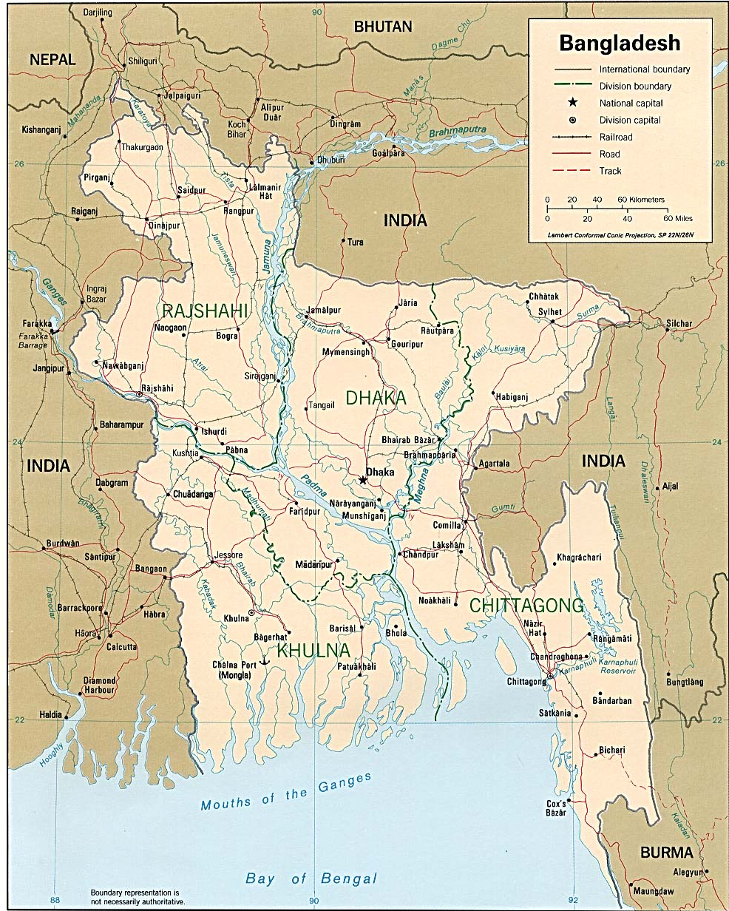
Where were the Bara-Bhuiyans?
Isha Kha
Protapadittyo Roy
Chand Roy & Kedar Roy
Kandarpa Roy
Lakhsam Manikyo
Mukundaram Roy
Others
Only six of them are shown here
The low-lying area of the greater districts of Dhaka, Mymensingh, Tippera and Sylhet, watered and surrounded by the Ganges, the Brahmaputra, and the Meghna and their numerous branches constituted Bhati in the days of Akbar and Jahangir, where the Bara-Bhuiyans rose to power.

Slide 5
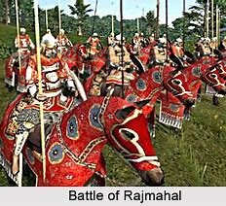
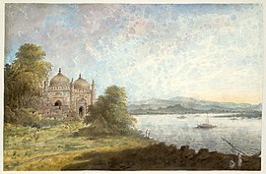
Rise of the bara-Bhuiyans
The Mughal Empire defeated the Sultanate at the Battle of Rajmahal on 12 July 1576, formally establishing the Bengal as the easternmost province of the subcontinent-wide empire.
Akbari mosque overlooking the Ganges at Rajmahal
Battle of Rajmahal

Slide 6
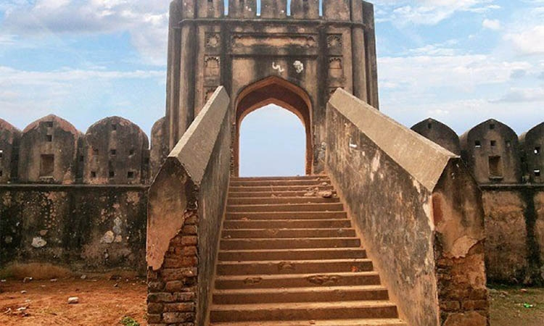
Rise of the bara-Bhuiyans
After the fall of the independent sultanate and particularly after the decentralisation of administration by Sher Shah, a chaotic condition and disruptive forces prevailed, particularly in the region of Bhati; the Bara-Bhuiyans gained strength and rose to power.
Hajiganj Fort aka. Khizrpur Fort

Slide 7
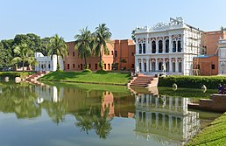
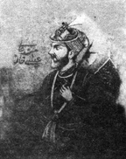
Isha Khan
Chief of Baro-Bhuiyans of Bengal
Sultan Ghiyasuddin Mahmud Shah
Sulaiman Khan (born in a rajput clan)
Masnad-i-Ala,
Isha Khan (1529-1599)
Musa Khan(1599–1610)
Masum Khan
Reign: 1576–1599
Zamindari: Sonargaon
Bara Sardar Bari called Isa Khan's zamindar bari in Sonargaon

Slide 8
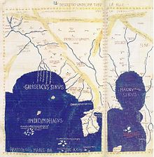
Isha Khan
All the battles fought against Mughal
Khan Jahan
(1578)
Shahbaz Khan
(1583)
(1586)
Laksmana Singh Hajra
(1585)
Durjan Singh
(1597)
Where Isa Khan fought Man Singh which ended inconclusively when Isa Khan stopped fighting after Man Singh’s sword broke. Both men developed respect for each other which culminated into a friendship. Later on, when Isa sought to submit to the Mughal under a guarantee that it was wiser for Mughals not to incite a full invasion, Man Singh accompanied him to the Mughal court.
It was only after his death, when the region went totally under Mughals.
Sonargaora mentioned in foreing map

Slide 9
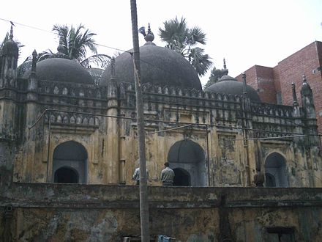
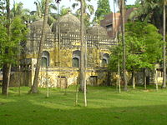
Musa Khan
Son of Isha Kha
10 July 1610 , dethroned and imprisoned by Islam Khan Chishti, the army general of Emperor Jahangir and Subahdar of Bengal.
During the office of Subahdar Ibrahim Khan Fath-i-Jang (1617-1624), Musa Khan became loyal to the Mughal force and was freed.
Grave of Musa Khan, Dhaka, Bangladesh
Reign: 1599-1611
Inherited Isha’s zamindari
Legacy of Musa Kha; Mosque built by his son Masum Khan

Slide 10
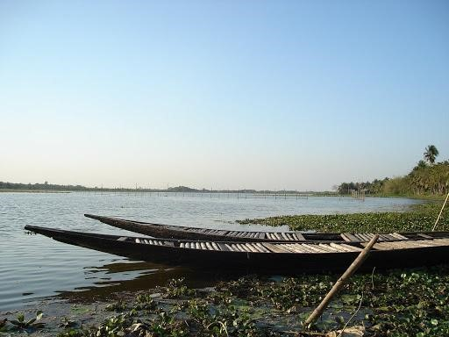
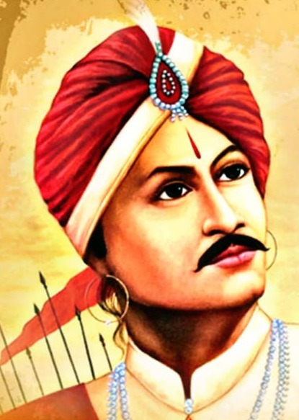
Protapadittyo Roy
Srihari (or Sridhar), was an influential officer in the service of Daud Khan Karrani, the last independent Sultanate of Bengal. who gave Srihari the title of 'Vikramaditya' and the zamindari of one Chand Khan, (Chandecan by the Portuguese).
On the fall of Daud Khan in 1576, Srihari declared independence and assumed the title of "Maharaja".
Pratapaditya was born to Srihari in 1561.
Srihari divided his kingdom –
Reign: 1583-1609
Jhapa Baor, arc-shaped lake of Jessor

Slide 11
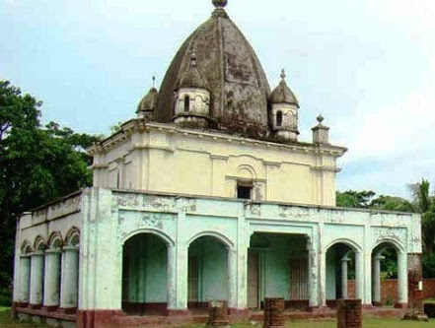
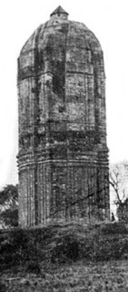
Protapadittyo Roy
Rise to power
Pratapaditya had his uncle murdered, with support from the Portuguese, and declared his independence. In return, for allowing the Missionaries to settle in his territories; the first Church in Bengal would be opened at Chandecan in about 1600.
Fort buit by Protap, Pratapnagar, near Sundarban in Assasuni Thana, Satkhira
Pratapaditya built the Jeshoreshwari Kali Temple. Jessore was the Capital of Pratapaditya.

Slide 12
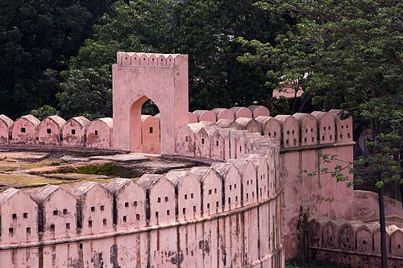
Chand Roy & Kedar Roy
The two brothers
Emperor Akbar established Bikrampur as one of the 52 parganas of Sonargaon sarkar in Bengal subah during his administrative reforms in 1572–1580. During his time, Chand Rai and Kedar Rai were the Zamindars of Bikramapur.
In the expeditions against Bara-Bhuiyans, Chand Rai was killed at the initial stage of the encounter. Mughal Subahdar Man Singh killed Kedar Rai in early 1600s.
Idrakpur Fort, Built: 1660 AD
Built by: Mir Jumla II

Slide 13
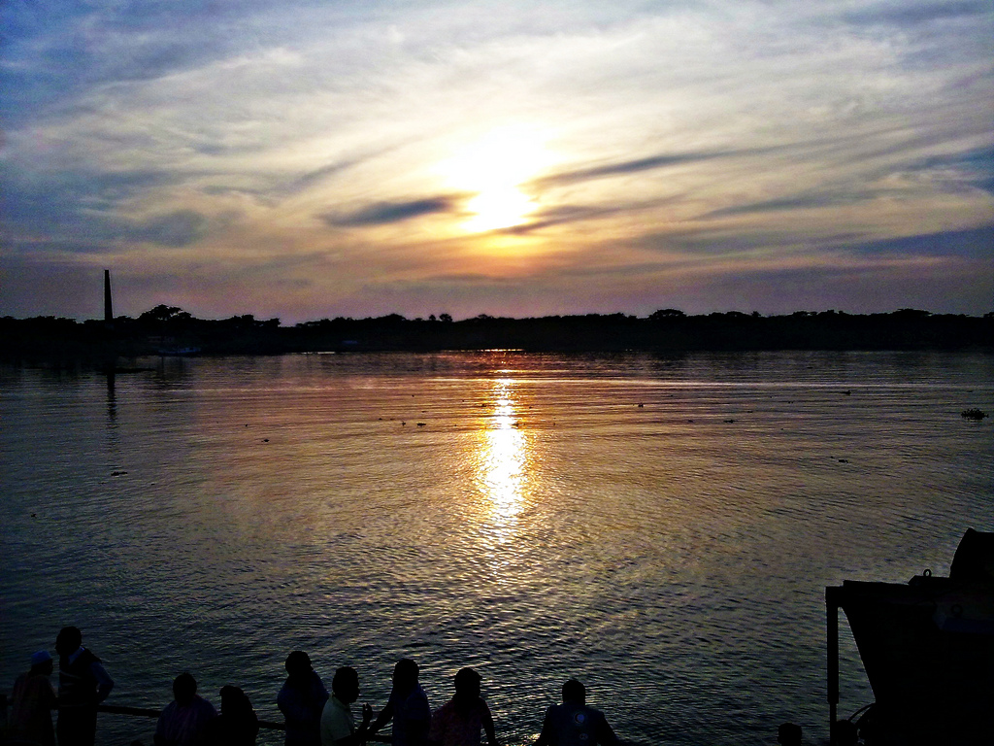
Kandarpa Roy
During the reign of Emperor Akbar, Raja Man Singh I (1594–1606) was the appointed Subahdar of Bengal and responsible for warding off rebellious chieftains in the region. The Chandradwip Kingdom was ruled by Raja Kandarpa Narayan Basu, who agreed to form an alliance Mughals. Kandarpa's son and successor Raja Ramchandra Basu broke this agreement in 1602, declaring Bakla's independence. Ramchandra was a close ally and son-in-law of Raja Pratapaditya of Jessore. His mother was against the idea of him breaking the agreement of his father and did not support warring with the Mughals.
Kirton khola river

Slide 14
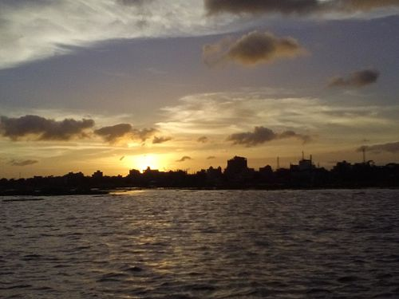
Lakxman Manikyo
The Bhulua Kingdom was then under the rule of Raja Lakshmana Manikya, one of the Baro-Bhuiyans of Bengal, and was succeeded by his son, Ananta Manikya.
Dakatia river, Noakhali

Slide 15
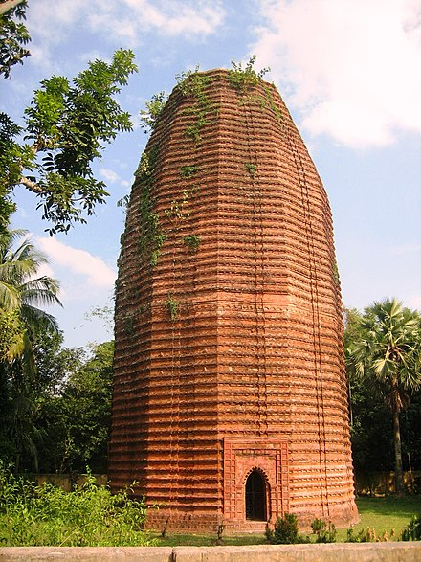
Mukundaram Roy
Bhuiya Mukundaram Roy paid tribute to the Mughals as he wished and acted subservient. Thus, he was practically an independent ruler.
The Bhushana kingdom of Bir Bhuiya Mukundaram Ray was formed during the Pathan-Mughal period with Madukhali Upazila, Greater Faridpur and parts of Jessore District in present-day Magura District of Bangladesh.
Mathurapur Deul, Faridpur; built by Bengal general, Sangram Singh

Slide 16
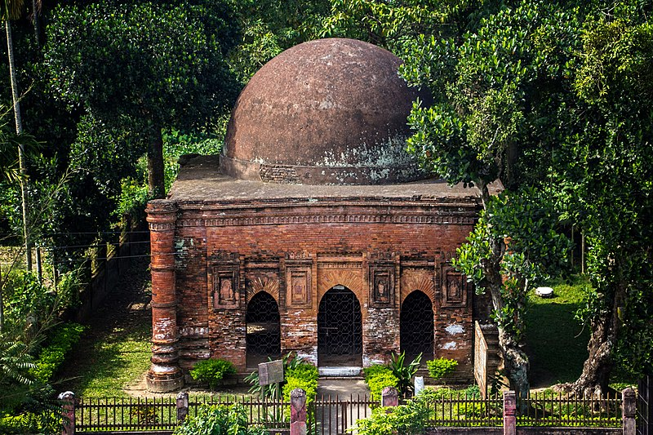
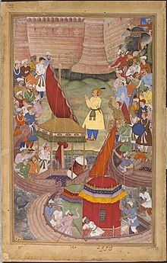
Fall
Subadar Islam Khan was able to defeat the Bara-Bhuiyans after Isa Khan’s death.
Islam Khan dethroned Musa Khan 2 times. But, the first time, he had to return to an ailing Emperor.
emperor Akbar rejoicing upon the Mughal conquest of Bengal
Sonargaon

Slide 17

Summary(time-stamped)
1585
1576
1583
Emperor Akbar sent Sadik Khan as Subadar of Bengal
battle of Rajmahal -> rise of the Baro Bhuiyans
Emperor Akbar sent Shabaj Khan as Subadar of Bengal
1599
1594
1586
Isa Khan’s death
Emperor Akbar sent King Man Singh as Subadar of Bengal
Emperor Akbar sent Uzir Khan as Subadar of Bengal
1603
Musa khan defeated at the hands of Man Singh but Man Singh returned toailing Emperor
1608
1605
Eperor Akbar died
Emperor Jahangir sent Islam Khan as Subadar of Bengal
Eperor Akbar died
1611
fight with other zamindars, fall of the Bara Bhuiyans
1610
1609
Musa Khna dethroned
fight between Musa nad Islam khan
A Mughal miniature showing emperor Akbar rejoicing upon the Mughal conquest of Bengal

